Slide 1


CONVOLUTION NEURAL NETWORK
Deep Learning
Presented By : Apsara B.K,Sristi Ghimire
Reviewed By : Sampada kharel,Subina Maharjhan, Rupesh Budhathoki,Sandip Nepali

Slide 2
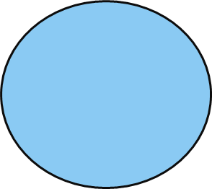
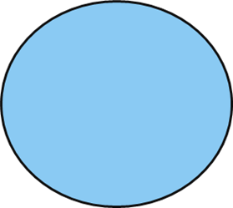
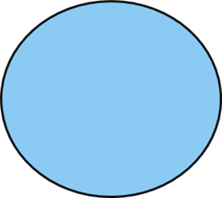



Table of contents
1
2
3
4
Introduction
of CNN
APPLICATION OF CNN?
How it
Works?
Architecture of CNN

Slide 3

ABOUT
CONVOLUTION NEURAL NETWORK
3

Slide 4
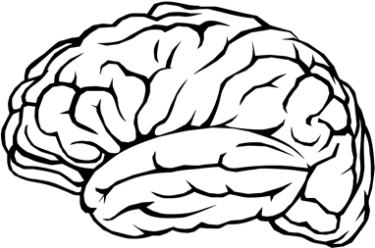
Convolution Neural Network(CNN)
Convolution neural networks (CNNs) are a type of artificial neural network used in deep learning. They are inspired by the structure of the brain and are used to recognize patterns in data.
CNNs are trained using large dataset of images and videos, and can learn to recognize and understand the visual environment in a way that is similar to how human would

Slide 5
Applications of CNN
Facial Emotion
Recognition
Face
Detection
Analyzing
documents
Medical
Imaging
Self-driving
Cars

Slide 6
Application of CNN
Facial emotion recognition
Different facial emotions such as sadness, anger, happiness, surprised can be distinguished with the help of CNN.
Face detection
Different faces can be detected present within the images. Basically, the network takes image as an input process it and produces a set of values which detects facial features. It also distinguish male and female.

Slide 7
Application of CNN
Analyzing documents
CNN model can identify which category a document belongs to based on the content in the document, such as article about politics, sports or academic.
Self-driving cars or autonomous vehicles
CNN model are main algorithm in self driving cars because it can be used for tasks such as obstacles detection, traffic sign recognition and lane detection.
Medical Imaging
CNNs are used in medical imaging to detect and diagnose diseases such as cancer and heart conditions.

Slide 8
How Convolution Neural Network works?
3
8

Slide 9
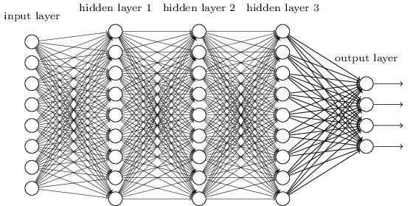
CNNs are composed of several layers of neurons that are organized in a hierarchical structure. Each layer is composed of a set of neurons that are connected to each other.
The neurons in each layer process the input data and pass the output to the next layer.

Slide 10

Image Recognition

Slide 11
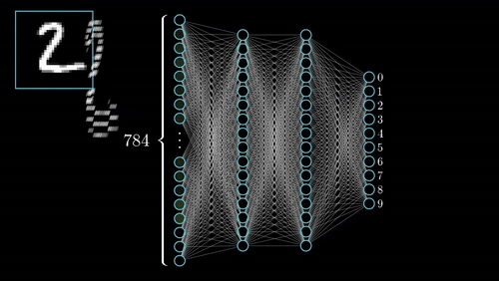
MNIST handwritten digit classification

Slide 12
4
Architecture of Convolution neural network
12

Slide 13
Architecture of Convolution neural network
The architecture of a CNN typically consists of several layers, including:
Convolutional layers: These layers apply a convolution operation to the input data, which helps to identify and extract features from the image.
Pooling layers: These layers are used to reduce the spatial dimensions of the convolutional layers, which helps to reduce the computational complexity of the network.
Fully connected layers: These layers are used to make predictions based on the features extracted by the convolutional and pooling layers.
Soft max layer: This is used to output probability distribution of the output.
13
Notes:
These layers are stacked on top of each other to form a deep neural network, which allows the model to learn increasingly complex features from the input data.

Slide 14
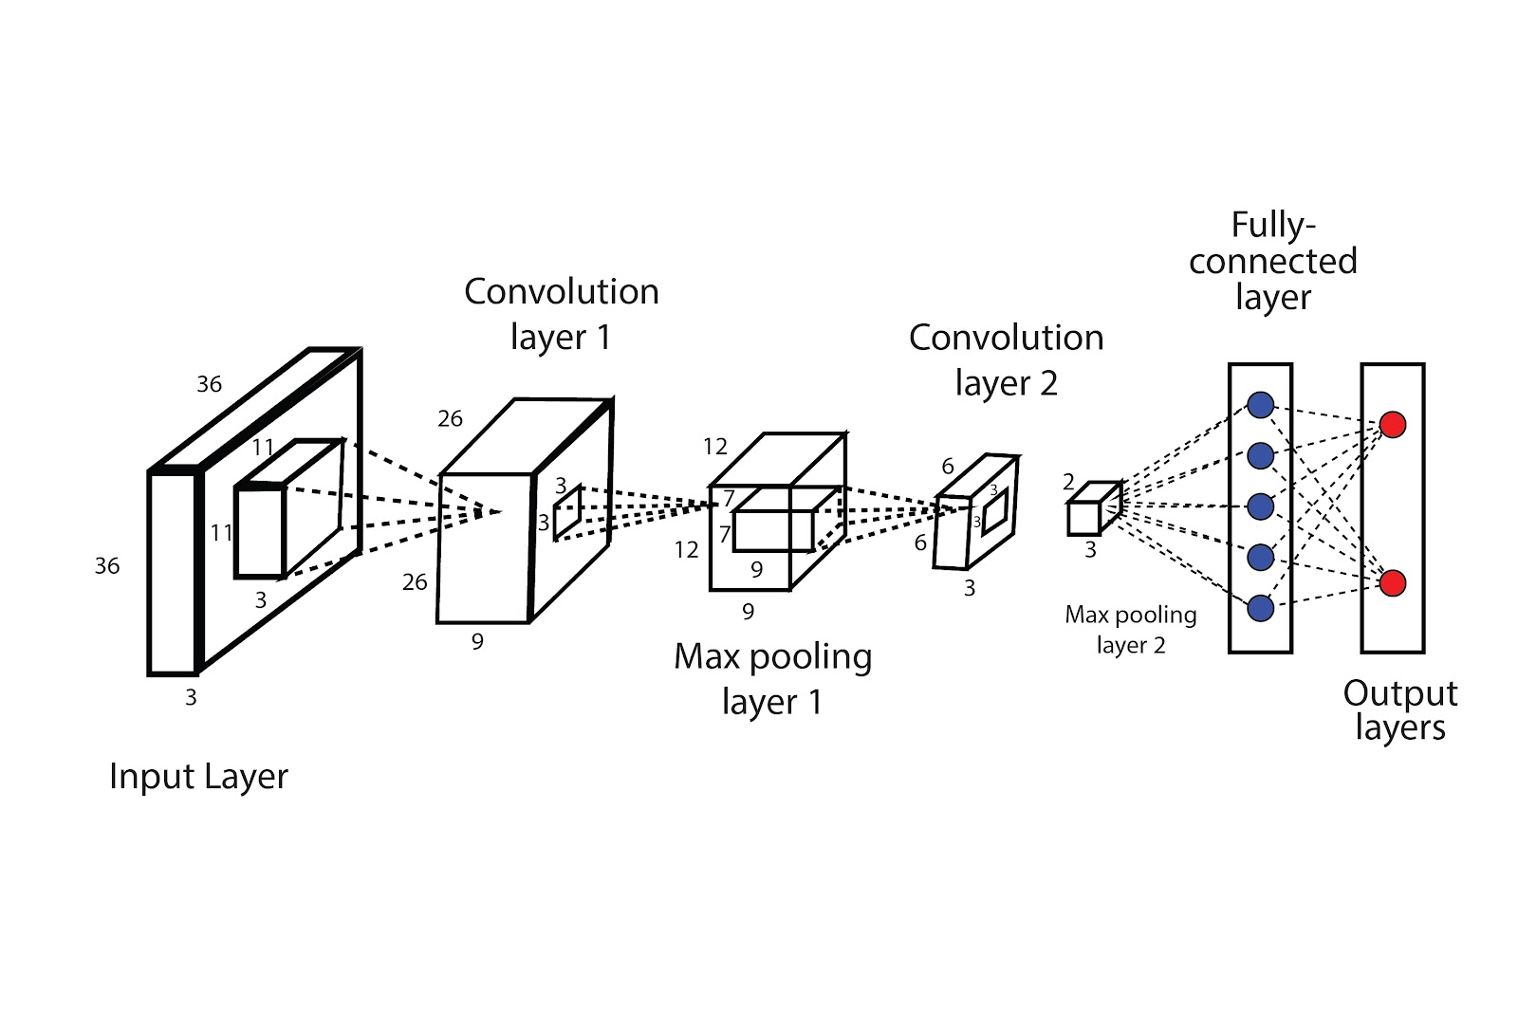
The architecture of Convolutional Neural Networks(CNN)
15

Slide 15



The Whole CNN
CAT
Convolution
Max Pooling
Fully Connected Feedforward network
Convolution
Max Pooling
Flattened

Slide 16

SUMMARY
A convolutional neural network (CNN) is a type of artificial neural network that uses convolutional layers to automatically and adaptively learn spatial hierarchies of features from input data such as images, videos and audio. It is designed to process data through multiple layers, each of which applies a series of filters to the input to extract key features, allowing the network to learn increasingly complex representations of the data.

Slide 17
References:
https://en.wikipedia.org/wiki/Convolutional_neural_network
https://www.analyticssteps.com/blogs/convolutional-neural-network-cnn-graphical-visualization-code-explanation
https://towardsdatascience.com/a-comprehensive-guide-to-convolutional-neural-networks-the-eli5-way-3bd2b1164a53

Slide 18
THANK YOU!!!

